Slide 1
Service Life Estimate for the ALCM Fuel Boost Pump Electronic Unit (FBPEU)
FOUO
Viet Tran
AFNWC/NDMEA
29 Sep 2016
Unclassified

Slide 2
Overview
FOUO
BLUF
Problem
Function & Location of FBPEU
Data Sources
ACI, REMIS Level 1 Pass Rate, Level 1 Regression Analysis
ASIA
Function Test Output Analysis, Teardown, Piece part Performance
Selecting Failure Mechanism (FM)
Analyze and Research Selected FM
Determine Scale Parameters & Reliability Function
Summary
Recommendations
FOUO
Unclassified

Slide 3
BLUF
FOUO
Fuel Boost Pump Electronic Unit (FBPEU) has an estimated service life of 2060
EMI protection assurance risk is at 2023
FOUO

Slide 4
The Problem
FOUO
Certain ALCM components are showing higher failure rates. These items are expected to impact the fleet over time.
MSD conducted a Service Life Estimate on the Fuel Boost Pump Electronic Unit (FBPEU) to support future missile sustainment decisions.
FOUO

Slide 5
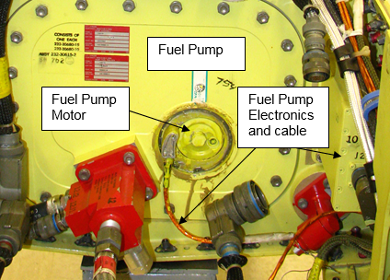
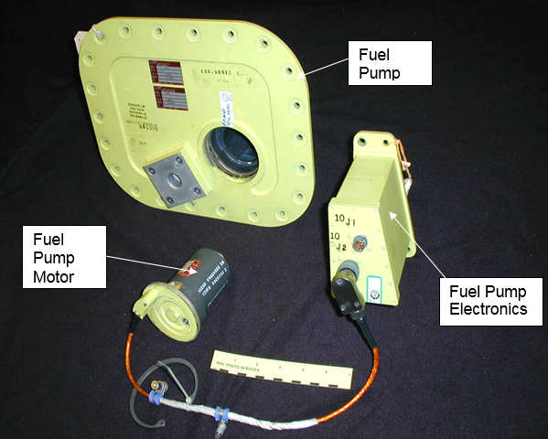
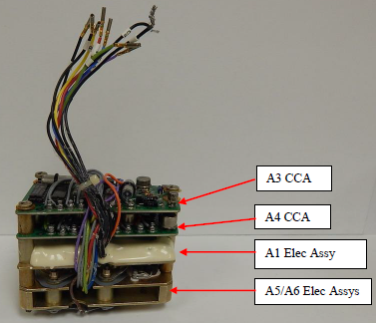
FBPEU Function and Location
FOUO
Function - FBPEU converts 28 Vdc power to 28 Vac power for use by the fuel pump
Location - FBPEU is mounted in the aft (engine) compartment of the missile
FBPEU Location
Note: An AC motor eliminates reliability problems associated with DC brushes
FOUO

Slide 6
Analytical Condition Inspection (ACI)
FOUO
ACI Visual Inspection
No record of discrepancy
ACI Functional Test
100% pass rate since 1992 – 2015
FOUO

Slide 7
Level 1 Pass Rate Analysis
REMIS Level 1 Pass Rate
No failures in the past 5 years
Year | 2010 | 2011 | 2012 | 2013 | 2014 | 2015
Total of FBPEU Failure | 0 | 0 | 0 | 0 | 0 | 0
Total Number of Level 1 Test | 85 | 250 | 314 | 257 | 288 | 224
Level 1 Pass Rate | 100% | 100% | 100% | 100% | 100% | 100%
Allocated Reliability Spec (Threshold) | 99.8%

Slide 8
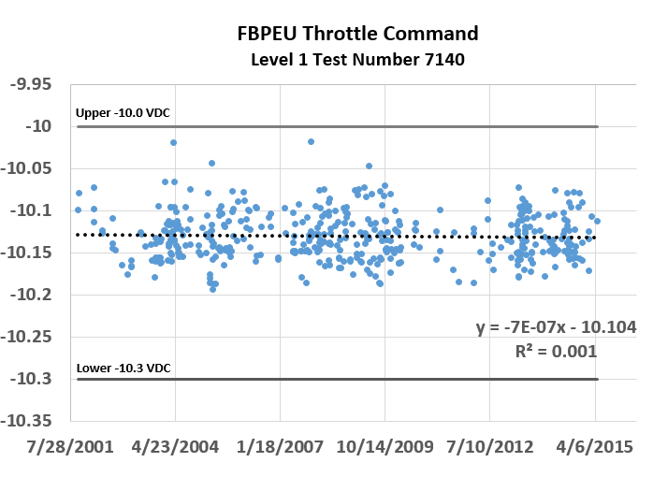
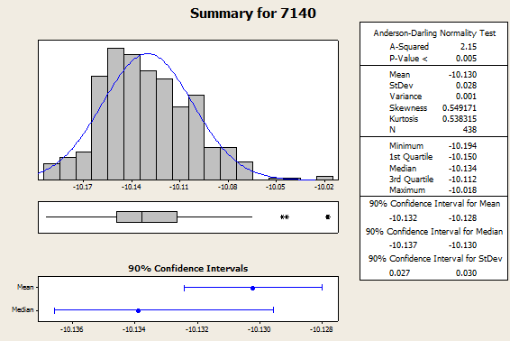
Regression Analysis – Throttle Command
FBPEU Level 1 Results 2001 - 2014
Linear Regression indicates no significant trend
Normal Distribution shows consistency within performance margins

Slide 9
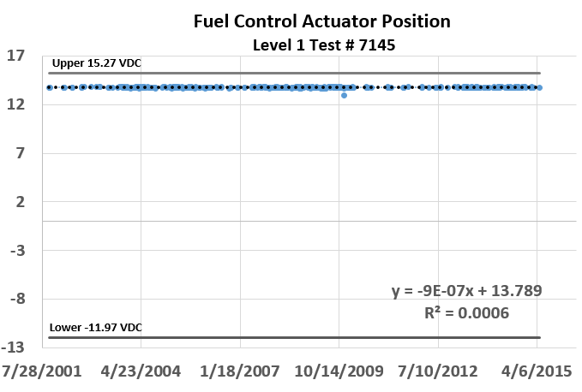
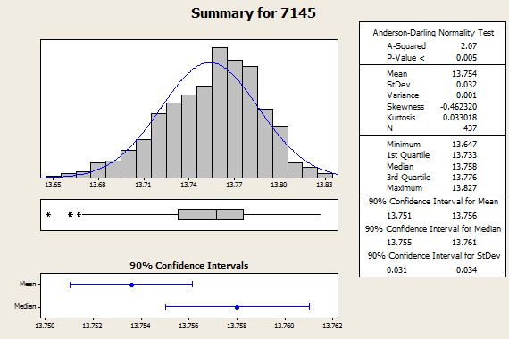
Regression Analysis –
Fuel Control Actuator Position
FBPEU Level 1 Results 2001 - 2014 Cont.
Linear Regression indicates no significant trend
Normal Distribution shows consistency within performance margins

Slide 10
Functional Test Results
FOUO
Functional test on 10 FBPEUs from supply (2016)
9 passed all parameters
1 failure – possibly due to test set up.
E-spectrum “One theory concludes that the manual test procedure used by the depot is prone to test setup errors and could easily lead to this type of failed indications”
FOUO

Slide 11
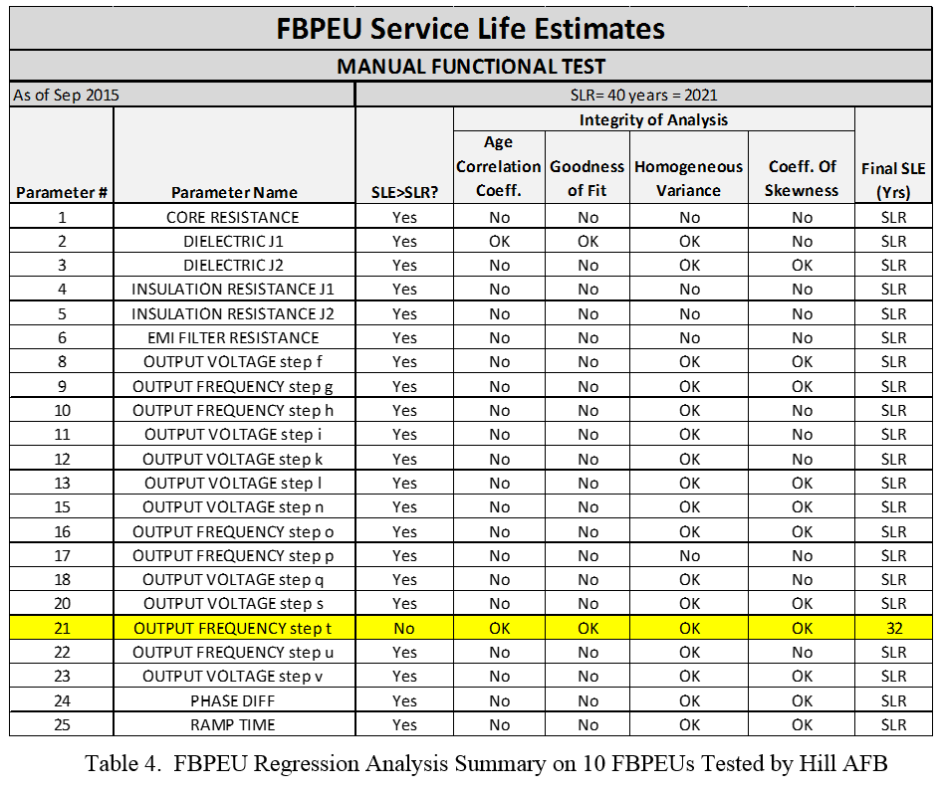
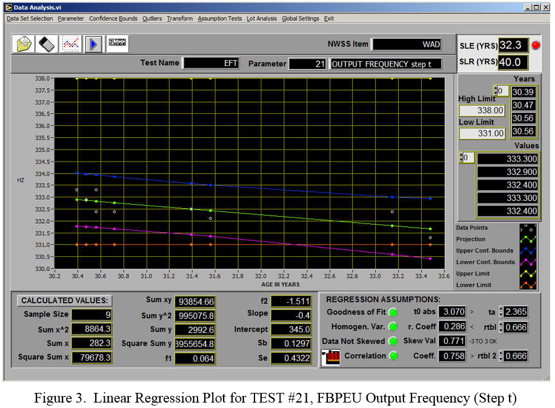
Function Test Output Analysis
FOUO
1 out of 25 parameters showed a trend
Slope of -.4 Hz per year, age of the FBPEUs tested was estimated based on serial number
FOUO

Slide 12
Teardown Analysis
3 FBPEUs were sent to E-spectrum for teardown analysis
Visual Inspection – Microcircuits show no irregularities or anomalies
60 piece parts selected for electrical parameter performance analysis (summary on next slide)
In-Depth Laboratory Analysis (Scanning Electron Microscope (SEM) & Energy Dispersive X-ray Spectroscopy (EDS)) 2 samples of each below:
Operational Amplifier, NPN Transistor, PNP Transistor, Transistor (OEM Unique), High Power Silicon Transistor, Microcircuit Voltage Comparator and Zener Diode show no evidence of any type of damage or aging
Wet Tantalum Capacitors showed electrolyte leakage

Slide 13
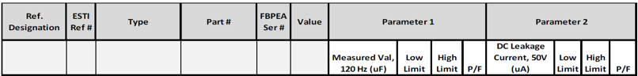
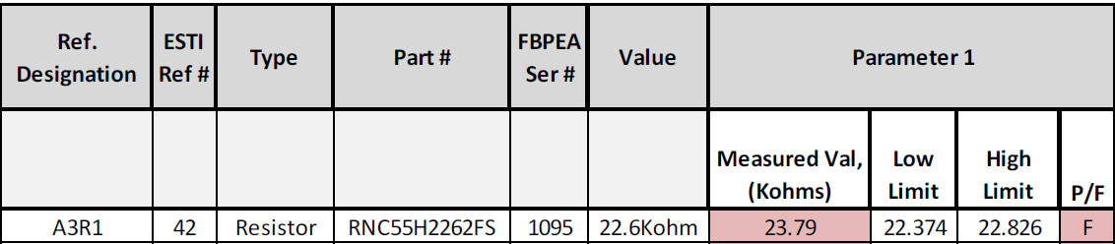
Component Level Electrical Parameter Performance
FOUO
Electrical Parameter Performance Test results from 60 piece parts
2 components exhibited test failures
A1C2 Wet Tantalum Capacitor from FBPEU S/N 398
Evidence supports manufacturing defect (low volume of electrolyte)
(Note: FBPEU S/N 398 passed all test parameters during functional testing)
A3R1 Metal Film Resistor from FBPEU S/N 1095
Specification allows 1% tolerance; test shows 4 % drift value
(Note: FBPEU S/N 1095 passed all test parameters during functional testing)
FOUO

Slide 14
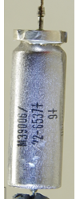
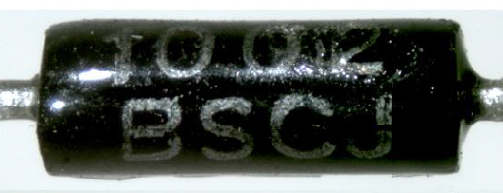
Selected Failure Mechanism
FOUO
WTC
Open circuit due to electrolyte leakage (well known issue in industry)
Metal Film Resistor
Resistance drifts higher with age due to thermal and electrical stress (well known issue in industry)
FOUO

Slide 15
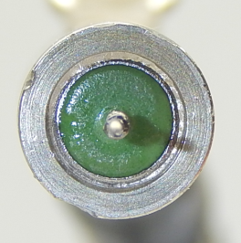
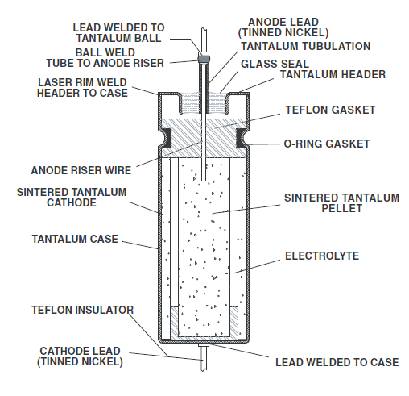
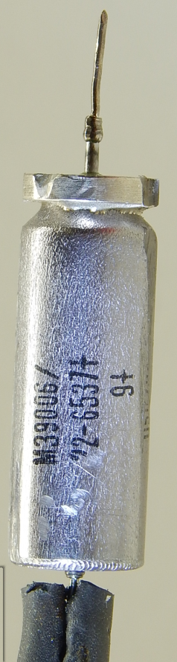
WTC Failure Mechanism
FOUO
WTC Failure Mechanism
Electrolyte (Sulfuric Acid H2SO4) leakage over time due to glass seal rupture, causes loss of capacitance which creates an open circuit
Vishay Intertechnology INC.
FOUO

Slide 16
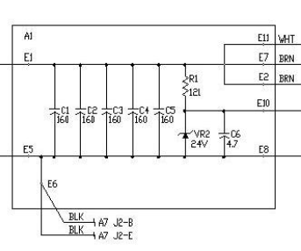
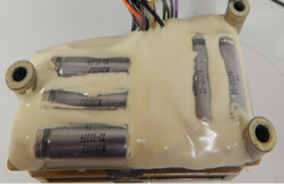
WTC Location
FOUO
A1 Circuit card (EMI filter) contains 5 WTCs
WTCs below are in parallel
FOUO

Slide 17
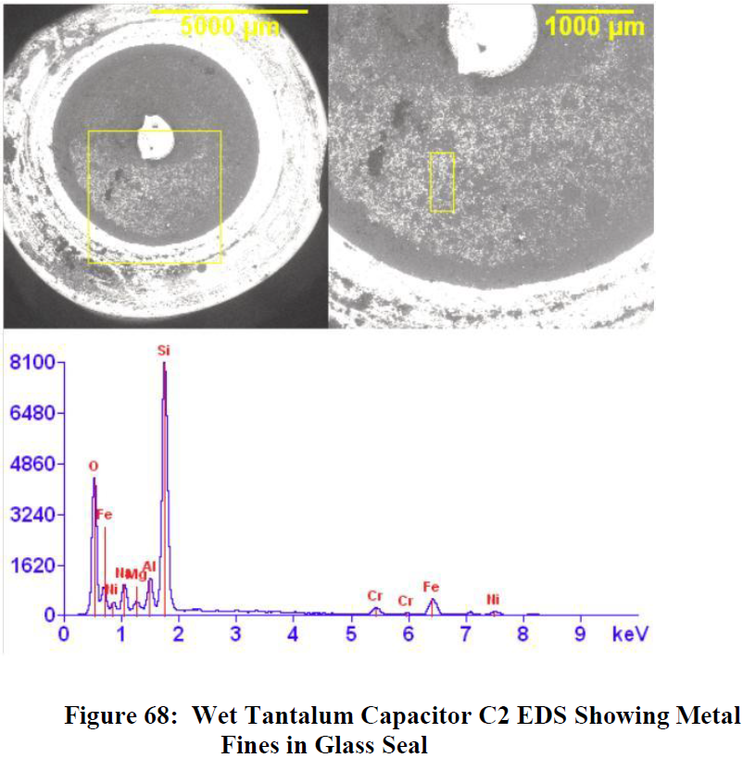
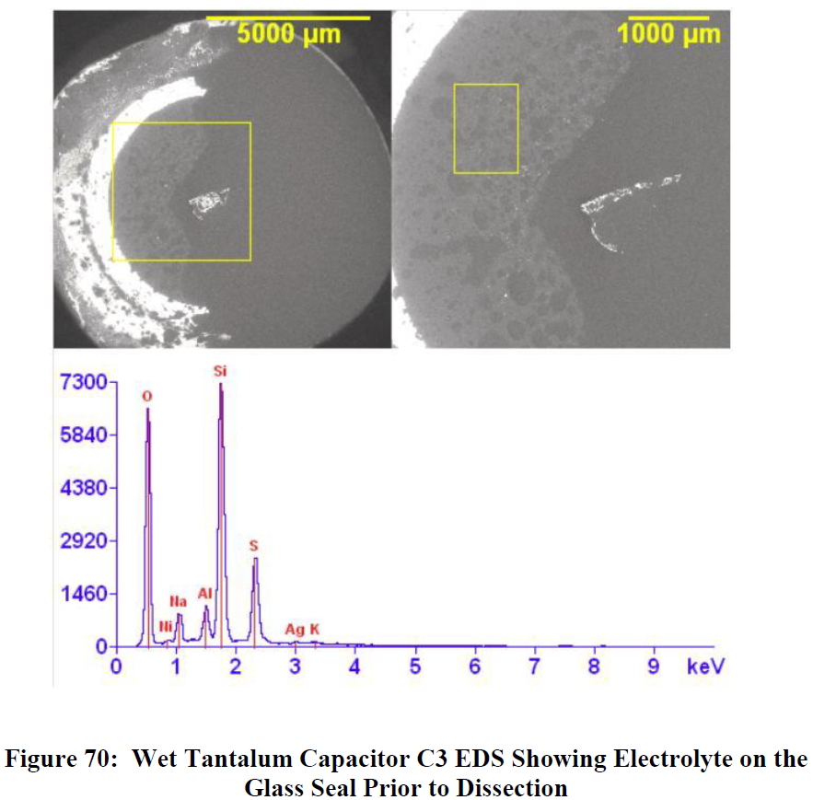
WTC X-Ray
FOUO
2 samples obtained from FBPEU S/N 398 Energy Dispersive X-Ray Spectroscopy (EDS)
Sample A (C2) was comparatively dry (i.e. little or no visible liquid after dissection), EDS shows no Sulfuric Acid on the glass seal surface, the cause of low levels of electrolyte could be not enough volume added during fabrication
Sample B (C3) electrolyte leaked past the swaged anode lead, EDS shows Sulfuric Acid has reached the glass seal surface. However, it passed Electrical Parameter Performance Test
Sample B
Sample A
Sulfuric Acid
FOUO
Notes:
Note: The disassembly activities required to remove the capacitor (Sample A) from the A1 Electronic Assembly resulted in some grinding on the metal case of the capacitors and most certainly resulted in this deposit of metal fines ( hot particle) in the glass seal.

Slide 18
WTC Electrolyte Research
FOUO
FAILURE MECHANISMS IN WET TANTALUM CAPACITORS ( Plessey Company Limited June 17, 1975)
The electrolyte boils at 128C (262F) at atmospheric pressure and hence considerable pressure develops at high temperature. However, there is a considerable safety margin for tubular units, normally rated up to 125C (257F), before actual seal rupture will occur.
At low temperature, the electrolyte used in devices rated to -55C freezes at -64C giving an open circuit. However, as soon as the temperature is raised the electrolyte melts and works normally. Thus, indefinite storage at-60C is quite permissible.
FOUO

Slide 19
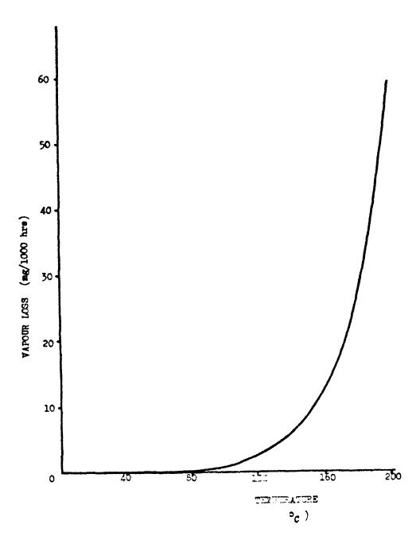
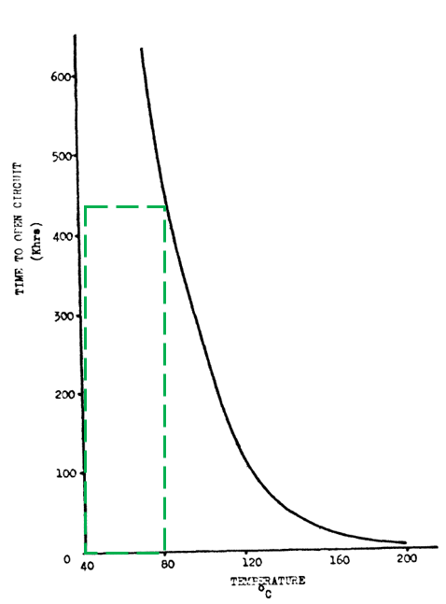
WTC Electrolyte Research
FOUO
FAILURE MECHANISMS IN WET TANTALUM CAPACITORS (Plessey Company Limited June 17, 1975)
“The wear-out mechanism of wet tantalum units is the loss of water vapor leading to open-circuit, although at rated temperatures, long life times are achieved”
FOUO

Slide 20
Stress Cycles Assumption
FOUO
Assumption:
ASIA teardown shows evidence of the onset of Electrolyte leakage which can take many years to complete. The WTC under evaluation are not exposed to high electrical stress condition but are exposed to many years of ambient thermal cycling which has a smaller effect on integrity of the seal. This calculation assumes the total failure mechanism full maturity is approximately 100 years (Eta median = 50 years)
Research shows WTC slope parameter (Betas) can range from 1.5 to 5. This calculation assumes a Beta of 3 due to the lack of test data
Based on data analysis and X-Ray results (initial stages of electrolyte leakage), the observed failure free life (Upsilon) of the WTC is estimated to be 25 years
Operational Margin (years) cannot be determine at this time due to the placement of the 5 parallel WTCs on the A1 circuit card in a configuration design for EMI protection (not detectable for normal ops)
FOUO

Slide 21
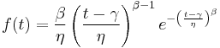
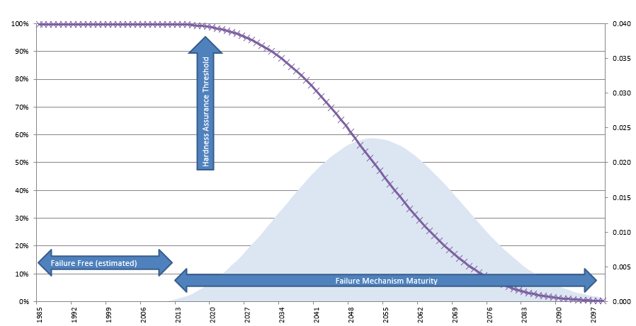
Reliability Function Based On Weibull Distribution
Eta equal to 50 years (failure mechanism maturity )
scale parameter - scales the curve along the x axis - time, cycles, etc.
Beta equal to 3 (rate of failure mechanism maturity)
shape parameter - or slope
Upsilon equal to 20 years (failure free life)
location parameter
Operation Margin – 0 years

Slide 22
LRU Hardness Assurance
FOUO
Projected hardness assurance of the FBPEU
Today
Hardness Assurance Threshold 98%
FOUO

Slide 23
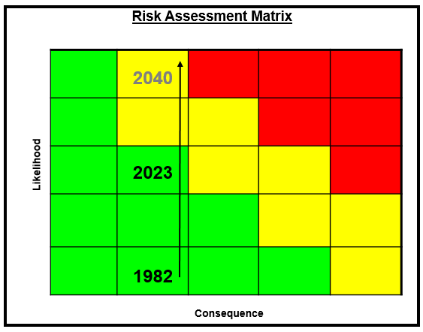
Hardness Assurance Risk
(EMI Filter) Hardness Assurance Risk based on the 2% degradation by 2023
WTC degradation will continue to accelerate
Note: Recent ALCM High Electro-Magnetic Pulse (HEMP) testing (2015 - 2016) verified hardness shielding integrity
Notes:
HEMP testing consist of two part: Skin-on and Cable shielding (Skin off).
Skin-on showed ALCM had proper shielding against HEMP
Skin-off showed cable shielding had proper EMP hardness protection during HEMP

Slide 24
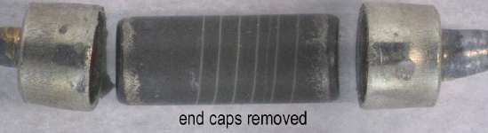
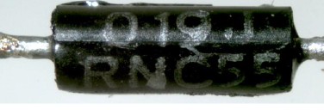
Metal Film Resistor (MFR) Failure Mechanism
FOUO
MFR Failure Mechanism
Thermal cycling effects film stability leading to oxidation of the resistance alloy and changing electrical characteristics
End Cap with leads
Ceramic Carrier
Thin Metal Film
FOUO

Slide 25
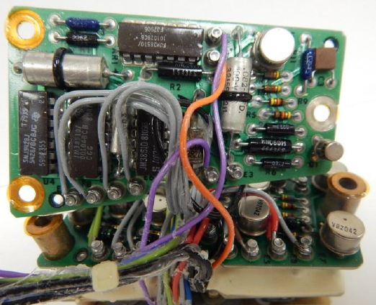
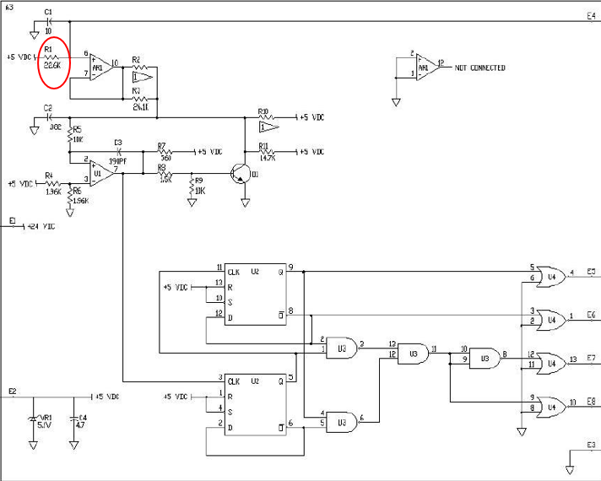
MFR Location
FOUO
A3 Circuit Card - Oscillator Control
(E-spectrum ASIA) Metal film resistor which has a robust structure that reduces sensitivity to most factors leading to instability and eventual change or drift in its’ resistance value. Since this particular resistor is in the oscillator circuit, and is connected to an external connector pin, the possibility of repetitive stress, as well as stress from an external component failure is in play
FOUO
Notes:
Thermal cycling effects film stability leads to oxidation of the resistance alloy, this could cause change in electrical characteristics

Slide 26
Metal Film Resistor (MFR) Stability
FOUO
The stability of a resistor depends primarily on its history of exposures to temperature changes. Stability is mainly affected by:
1) Changes in the ambient temperature and heat from adjacent components
2) Destabilizing thermal shock, caused by a sudden application of power
3) Long-term exposure to high temperature and applied power (load-life stability)
4) Repetitive stresses from being switched on and Off
Above conditions are not anticipated for FBPEU’s components
This resistor experiences normal environmental thermal cycles which will slightly accelerate resistance drift due to age
FOUO

Slide 27
MFR Service Life Factors
FOUO
MFR characteristics
MFR design = 22.8k +/- 1% ohms
Electrical performance test shows resistance drift of 2.77%
Assumptions
Near linear drift (commonly known)
Circuit card assembly tolerance 3%
LRU operational design tolerance 5%
Resistance drift impacts LRU operation at 7% (Operational Design + 2%)
No extreme thermal or electrical stress
FOUO

Slide 28
MFR Resistance Drift Maturity
FOUO
Projected service life estimate of the FBPEU is 2060
FOUO

Slide 29
Summary
FBPEU ACI 100% pass rate, Level 1 100% pass rate, functional test indicated only 1 parameter with trend and teardown analysis identified limited age related effects
MFR resistance drift will likely impact Oscillator (A1circuit card) frequency and voltage over time. However, the drift detected in functional testing is many years from reaching the estimated operational margin
WTC electrolyte leakage will likely create an open circuit in the EMI filter (A3 circuit card). However, this risk applies to electromagnetic hardness protection, not to functional operation
Both MFR and WTC performance will be simulated in PSPICE to determine critical operational margins

Slide 30
Recommendation
Recommended Next Steps
Rate FBPEU Green on ALCM Technical Assessment
Simulate FBPEU performance in PSPICE
Continue to monitor through ACI functional testing

Slide 32
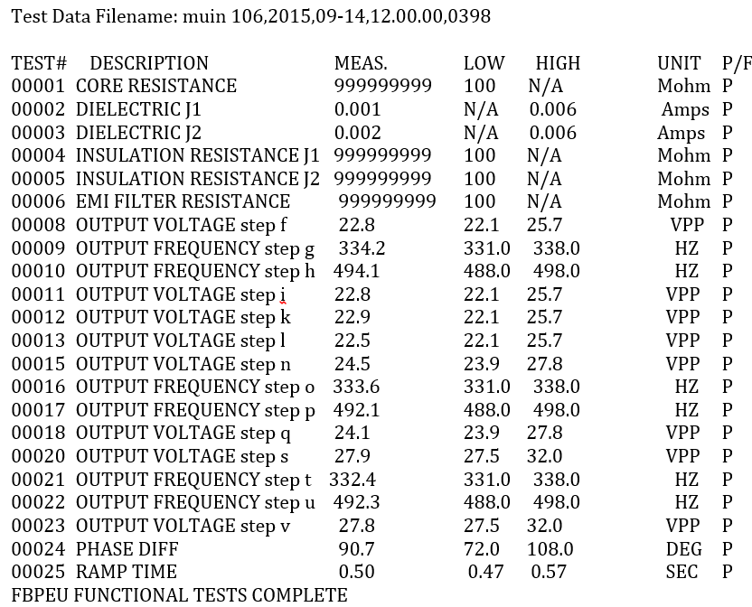
Back Up
Test Out Put Sample

Slide 33
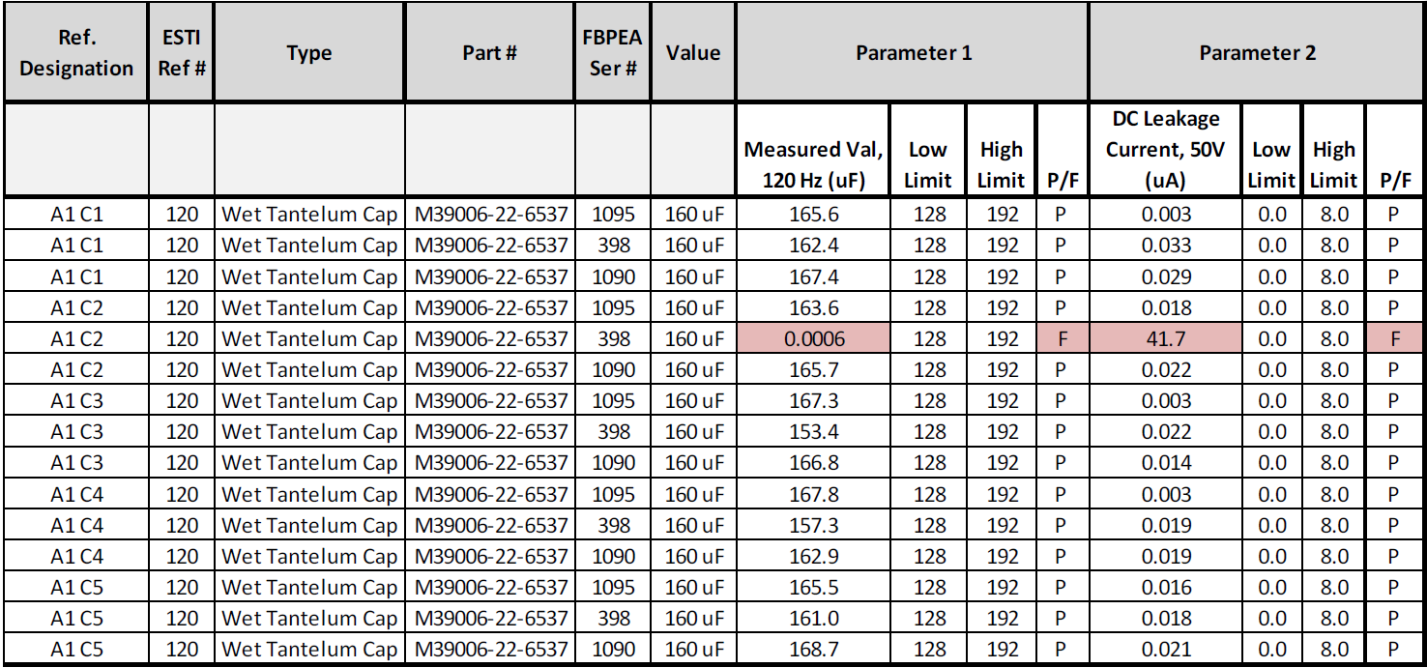
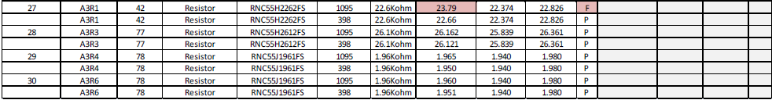

Slide 34
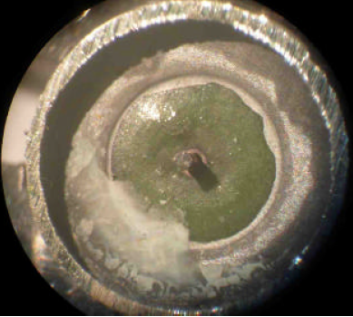
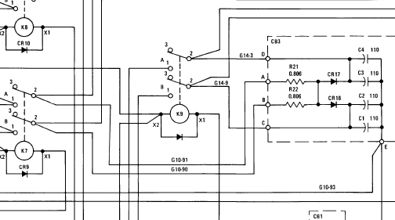
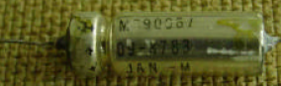
WTC Comparison
Comparing WTC
WTC on WAD CB3. Silver migrating (metal migration) across the glass seal toward the lead. (Note: These capacitors are used in the impact sensor trigger circuit to provide the final fuzing signal to the warhead)
WTC on FBPEU A1 Card. Due to similar design, it is likely the same failure mechanism exist. However, Silver migrating showed no signs of this condition in the two samples analyzed
WAD CB3
WAD WTC

Slide 35
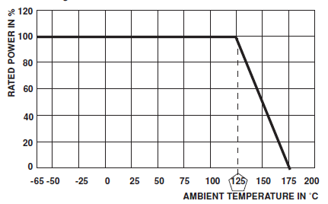
Vishay Spec
Mil-PRF-55182 (Vishay Intertechnology INC.)
Failure Rate % per 1000 hours = 0.001%
Power ratings are based on the following two conditions:
± 2.0% maximum ΔR in 10000 hours load life.
+ 175°C maximum operating temperature

Slide 36
MFR Comparison
Recent ASIA shows Elevon Actuator Controller is also contains RNC55 Metal Film Resistor
Two samples from EAC ASIA were tested for electrical performance, both measured outside of threshold limitation. However, other inspection such as X-ray, SEM, and disassemble visual inspection shows no anomalies

Slide 37
OPERATIONAL THRESHOLD
MSD creating an electronic circuit simulation of FBPEU circuit card assemblies to determine better estimate of operational margin
FDE & FGT confirmed no failure due to FBPEU degradation
Operational threshold is set at operational design plus an additional 2% of resistance drift

